Slide 1

Project Nanomedicine: A Key enabling technology
2011049- Anabil Dey
2011050- Shadman Nahiyan
2011051-Farin Nowshin
2011052-Saiful Islam Nadim
2011053-Md. Atik Faisal
2011054-Jihan Mahbub Khan

Slide 2
Nanomedicine: The use of nanoparticles or nanotechnology in healthcare can be referred as nanomedicine. Nanomedicine has the potential to enable early detection and prevention and to drastically improve diagnosis, treatment and follow-up of many diseases including cancer.
Applications Of Nanomedicine
Therapeutics
Diagnostics
Regenerative
Our project is to optimize the growing demand of nanomedicine by developing necessary technologies for specific purposes.

Slide 3

Objectives:
Ensure funding and encourage investors to initialize the project.
To establish an R&D department comprising of skilled professional relevant to the project and its applications.
Establish a marketing and management team overlooking the research project.
Develop targeted technology according to need
Test the developed technology on multiorgan microdevices.
Release the product in the market and ensure profit after a couple of years.

Slide 4
Expected Outcome:
Enable early detection & prevention
Improve diagnosis
Developing bio-synthetic & eco-friendly technology
Introducing non-invasive feature
Ensuring faster, more-efficient life-saving treatments

Slide 5

Scope:
The global nanomedicine market is expected to expand at a compound annual growth rate (CAGR) of 11.7% from 2022 to 2030.
2009
$53 Billoin
2021
$156 Billion
2025
$334 Billion
Development and commercialization of the techniques that holds potential to significantly improve the administration of drugs and disease management is expected to drive the adoption of nanomedicines in this market. Furthermore, growing adoption of nanotechnology-based drug delivery methods coupled with inefficiency of conventional therapeutics in disease treatment has driven the nanomedicine market growth.​

Slide 6
Project Initiation:
Project Management Team
Research
Material Scientist
Pharmacist
Medical investigator
Doctor
Data Analyst
Technology
Software Engineer
Mechanical Engineer
Medicaldevice expert
Nanotech Expert
Manufacturing Engineer
Physicist
Financial Advisor
Portfolio Manager
Brand management
Management
Product Manager
Marketing & Media
Advertising
Customer & market Research
Sales

Slide 7
Execution Plan :
Define Scope & Objectives
Conduct Market Research
Assemble Project Team
Developing Detailed plan
Secure Funding
Conduct Preclinical Trials
Obtain regulatory approval
Obtain Market Authorization
Launch Product
Monitor & Evaluate

Slide 8

Project Budgeting:
Researcher:
$300,000
Technologist:
$270,000
Management:
$200,000
Marketing:
$250,000

Slide 9
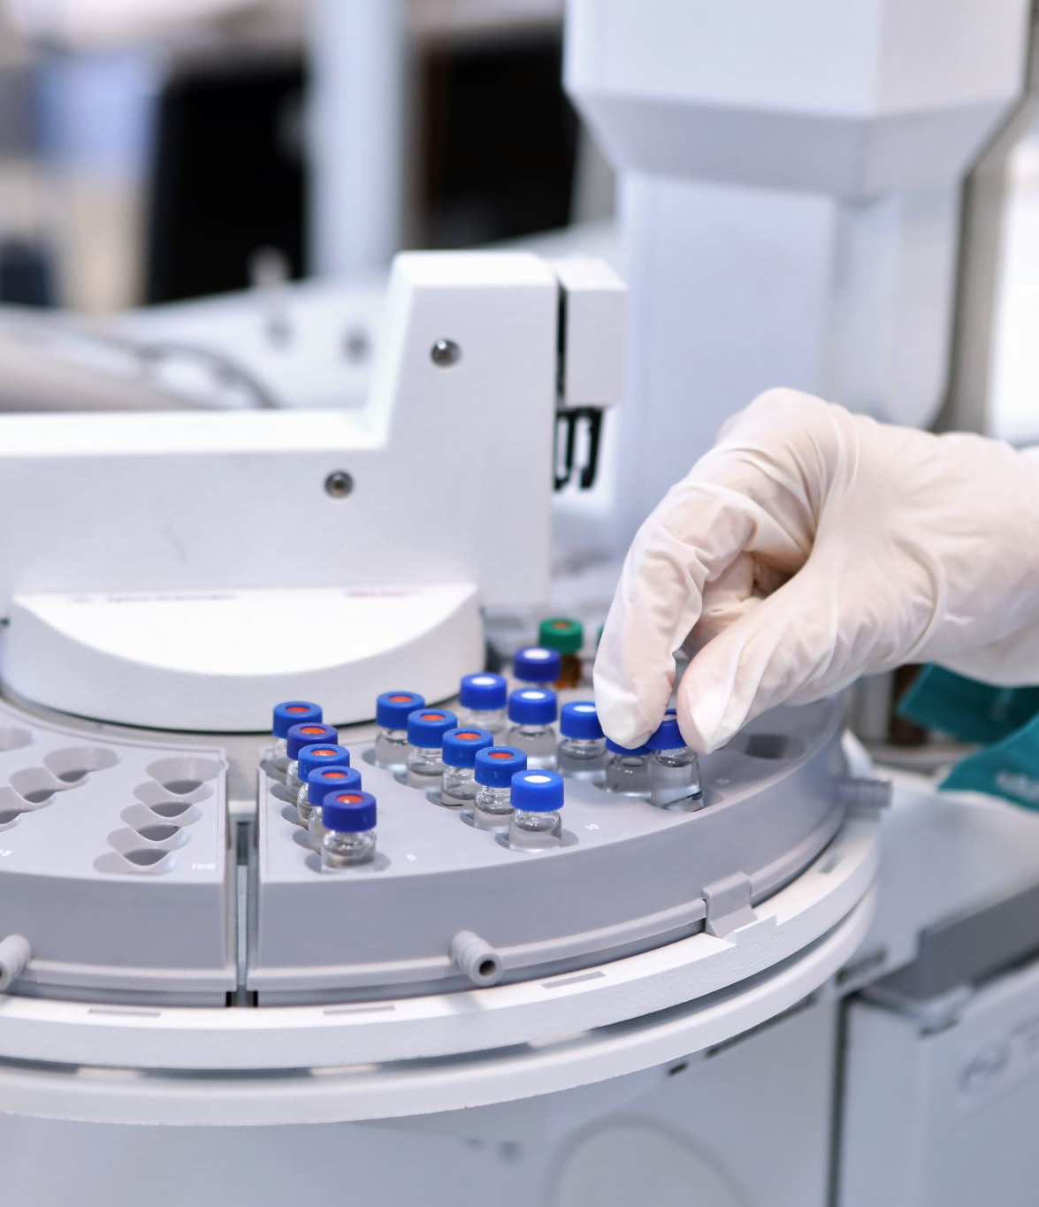
Project Budgeting:
Equipment:
Synthesis and characterization equipment (e.g. nanoparticle synthesizer, dynamic light scattering, transmission electron microscope): $500.000 In vitro and in vivo testing equipment (e.g. cell culture hood, centrifuge, animal housing): $250.000 Computer and software (e.g. data analysis software, imaging software): $50,000
Total: $800,000
Supplies:
Chemicals and reagents for nanoparticle synthesis and characterization: $50,000 per year Lab consumables (e.g. pipettes, petri dishes): $20,000 per year Animal care and maintenance: $30,000 per year
Total: $100,000 per year

Slide 10
Travel:
Conferences and meetings to present research and network with other scientists: $20,000 per year Fieldwork, if required: $10,000 per year
Total: $30,000 per year
Miscellaneous:
Insurance: $5,000 per year Miscellaneous expenses (e.g. office supplies, internet access): S5,000 per year
Total: $10,000 per year

Slide 11
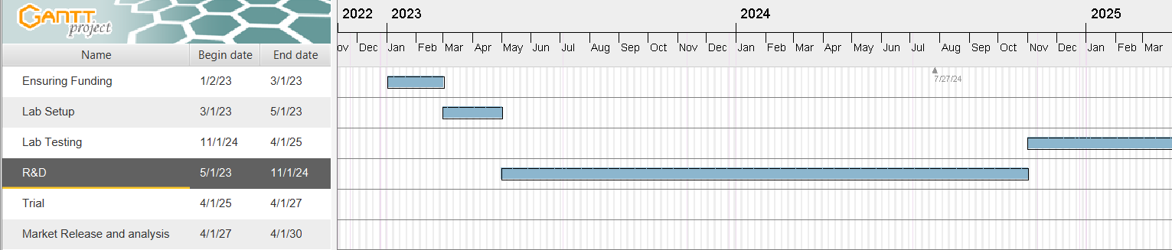

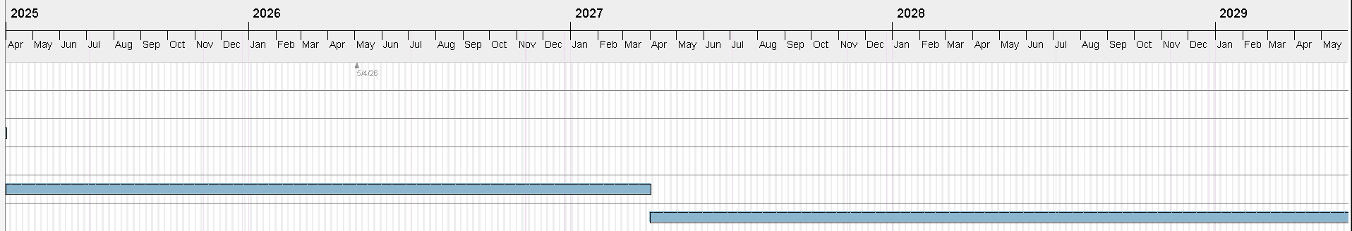
Gantt Chart

Slide 12
Organisations to approach:
Gov. Agencies
Academic Instituitions
Private foundations
Biotech & Pharma companies
Investment firms
Industry associations
Patient advocacy group
Here is a list of some well-known biotech and pharmaceutical companies: Roche, Pfizer, Merck & Co., Novartis, Sanofi, GlaxoSmithKline (GSK), AstraZeneca,
AbbVie

Slide 13
Communication plan:
Stakeholder Analysis
Communication Objectives
Communication Channel
Message Content
Timing
Responsibility
Feedback
Contingency Plan
Evaluation

Slide 14
Some of the common risks associated with a nanomedicine project include:
Regulatory approval
Technical challenges
Clinical trial risks
Market competition
Intellectual property
Manufacturing risks
Financing risks
Market acceptance
Patient safety
Collaboration risks

Slide 15
Conclusion:
In conclusion, nanomedicine is a rapidly growing field that offers great potential for revolutionizing medical treatment. By utilizing nanoscale materials and devices, researchers are exploring new ways to diagnose and treat diseases, improve drug delivery systems, and enhance imaging capabilities. Despite its promising prospects, there are also significant challenges that must be overcome, including improving the safety and biocompatibility of nanomaterials, developing more effective and targeted delivery systems, and addressing regulatory and ethical concerns. Overall, the future of nanomedicine looks bright, and continued research and development will be essential for realizing its full potential in improving human health.

